Slide 1
Agentic RAG Chatbot for Multi-Format Document QA using MCP
Powered by agent-based architecture and context-aware LLMs
Brief bullet points:
Supports PDF, DOCX, PPTX, CSV, TXT
Retrieval-Augmented Generation with 3 agents
Uses Model Context Protocol (MCP) for agent interaction

Slide 2
Agent Architecture (MCP Integration)
🧩 IngestionAgent
→ Parses and preprocesses uploaded documents Function: Extracts raw content, cleans it, and prepares it for downstream processing.
⬇️
📚 RetrievalAgent
→ Embeds documents and retrieves top relevant chunks Function: Converts cleaned text into embeddings and performs semantic search based on user queries.
⬇️
🤖 LLMResponseAgent
→ Uses context to generate the final answer Function: Forms the LLM input, injects retrieved context, and returns a structured, natural language response.

Slide 3
Tech Stack
Layer | Technology
Frontend (UI) | Streamlit
Backend Agents | python
Protocol | In-memory Bus (MCP)
Embeddings | OpenAI
Vector Store | FAISS
Document Parsing | PyMuPDF, python-docx, etc.

Slide 4
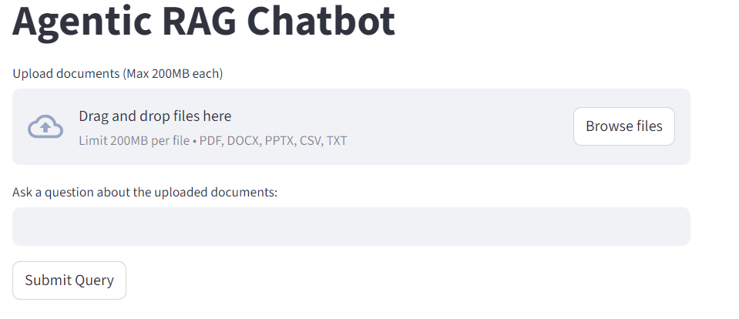
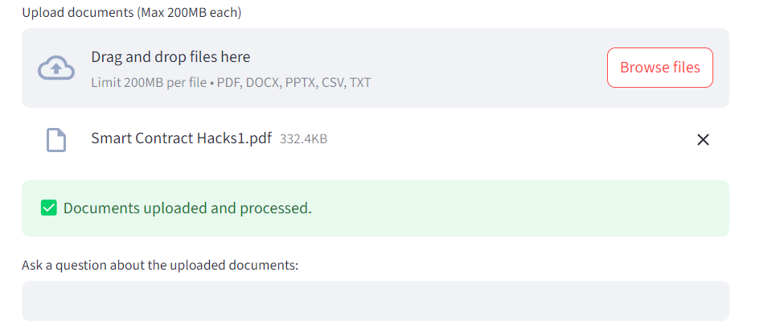
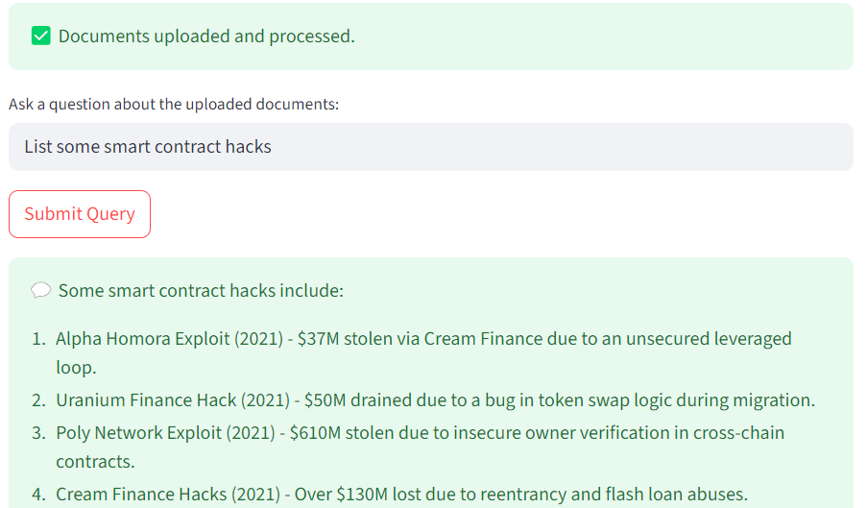
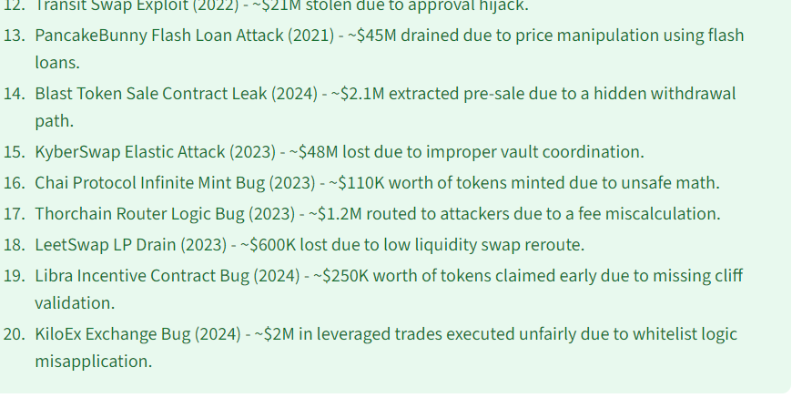
System Flow Diagram

Slide 5
Challenges & Future Scope
Challenges:
Document parsing edge cases
Embedding quality for long docs
Designing consistent MCP trace/message format
Future Scope:
Add file summarization agent
Add audio/video parsing
Switch to LangChain or agentic framework for scalability

